Slide 1
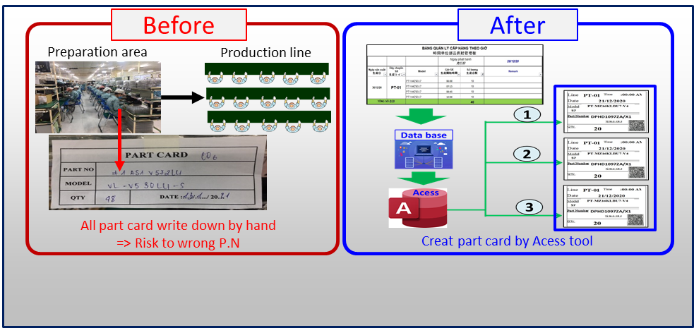
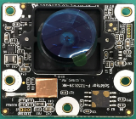
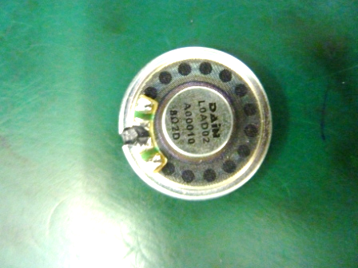
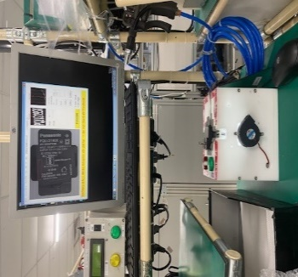
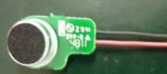
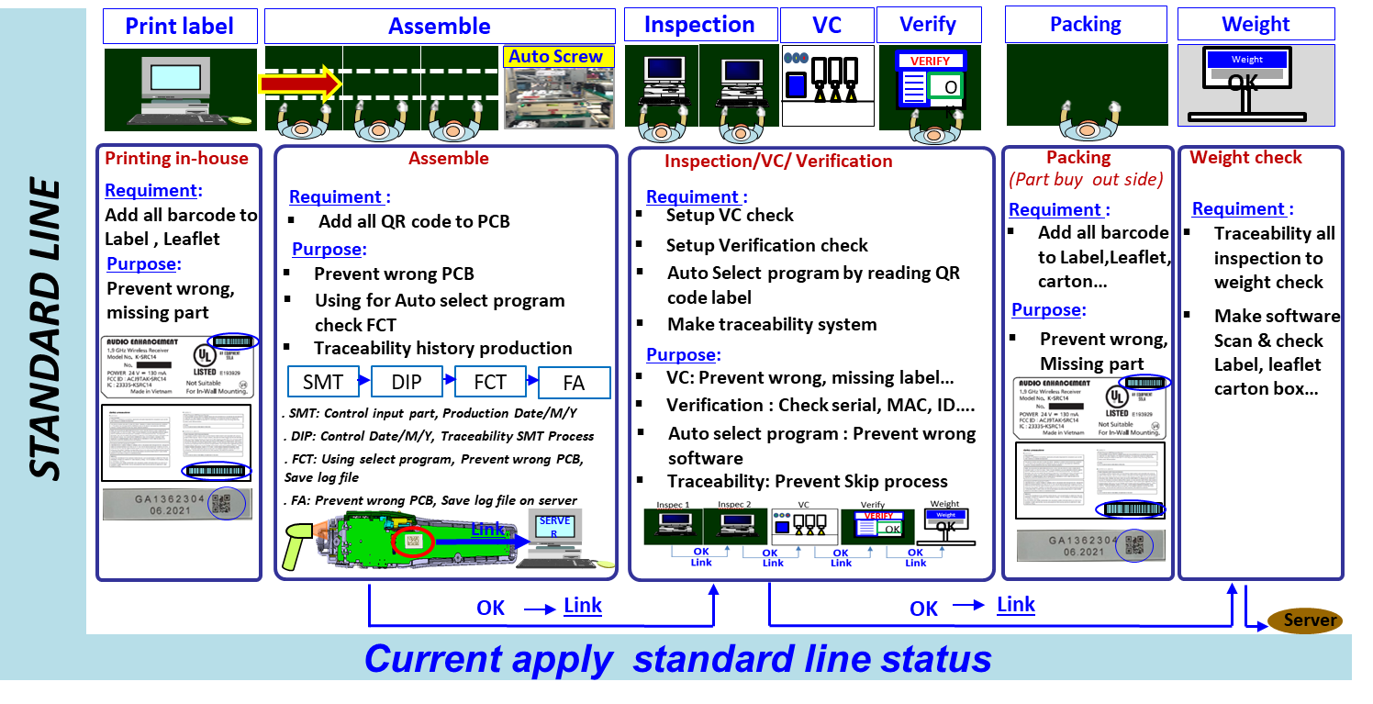
SCBU - FY2022 Improvement Activity
BU | FY22 Action | Plan / Schedule | Concerned Department
SCBU | Auto Creat Part Card : Print Label Area & Prepararion Area | Plan : DP & DECT : 2 Lines (Print Label & Prepararion Area) Schedule : Jun.2022 – Jul.2022 | IT
 | Add VC Camera for important electrical parts :Camera module / Speaker/MIC | Plan : DP : 8 Lines Dect : N/A Schedule : May – Sep.22 : CMR Module Oct – Mar.23 : Speaker/ MIC | PE
 | Build a Quality assurance system according Standard sample line [100% for New model , new category] : | Plan : DP : 8 Lines Dect : 8 Lines Schedule : Follow New Model / New category schedule | PE IT
Camera Module
Speaker Parts
MIC

Slide 2
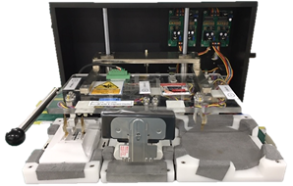
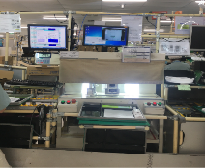
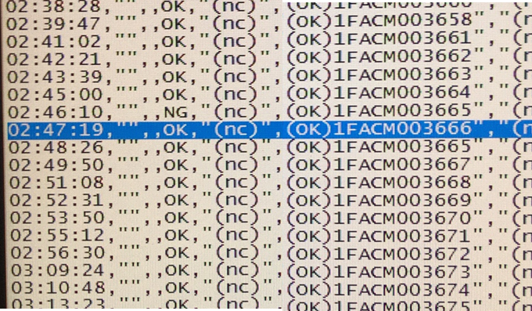
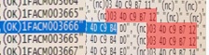
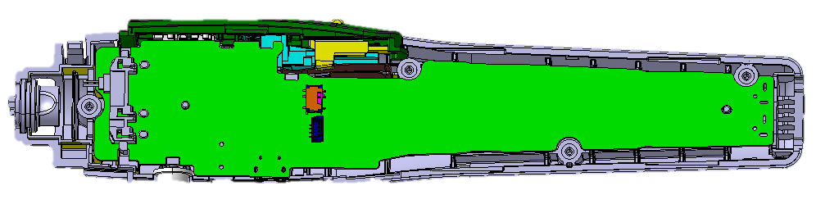
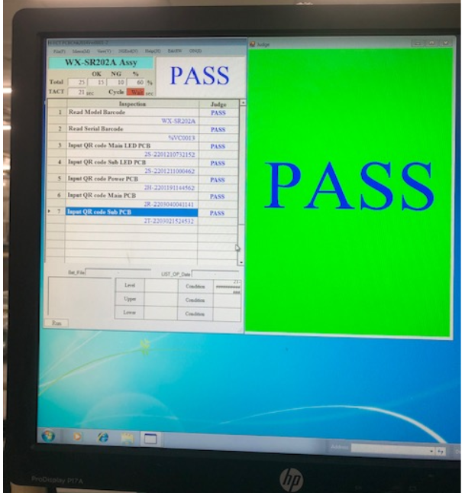
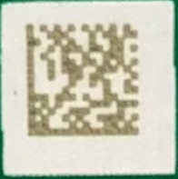
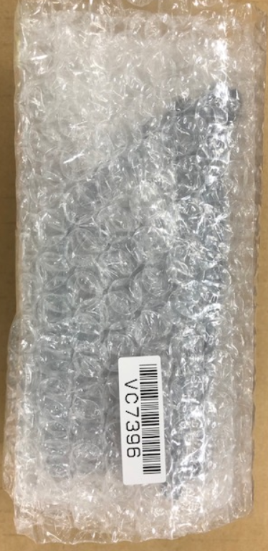
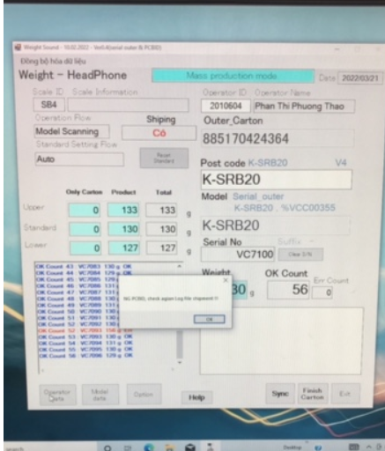
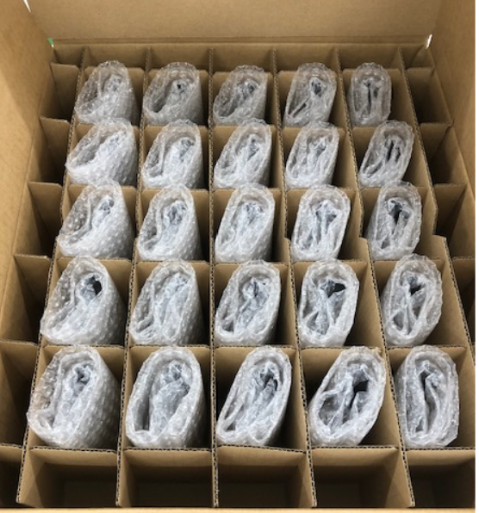
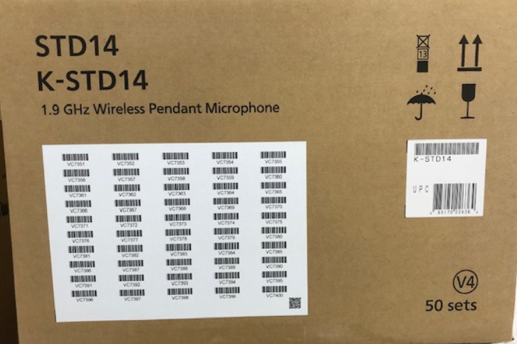
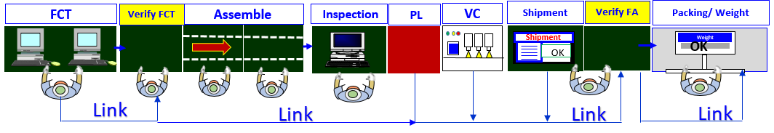
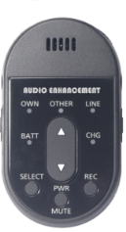
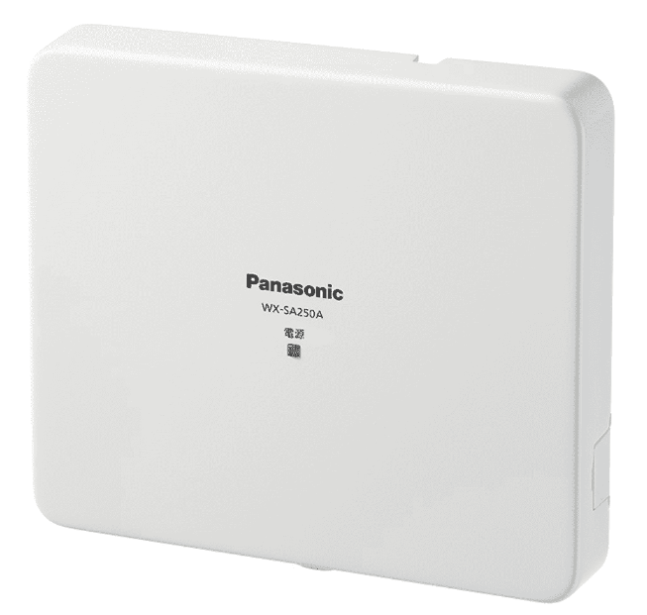
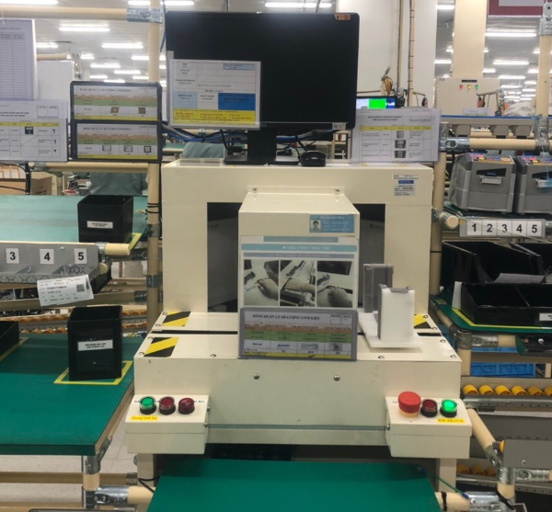
MEBD - FY2022 Improvement Activity
BU | FY22 Action | Plan / Schedule | Concerned Department
MEBD | Make Software Prevent Double ID, Double Serial No | Plan : Sound Biz : 10 Lines Schedule : May.2022 | IT PE
 | Make software to check PCB part No | Plan : Sound Biz : 10 Lines Schedule : May.2022 | IT PE
 | Improve weight check software auto compare serial inner with serial outer box | Plan : Sound Biz : 10 Lines Schedule : Apr.2022 | PE IT
 | Apply Verify system to prevent skip process | Plan : Sound Biz : 10 Lines Schedule : ~ Apr.2022: OK 6/6Line ~ May~Oct.22: OK 4Line | PE IT
 | Setup VC to appearance checking | Plan : Sound Biz : 10 Lines Schedule : ~ Apr.2022: OK 2 Line ~ May~Feb.23: 8Line | PE
OK
5kg
Shipping set up
Weight check
S/N + ID Link
In case double ID for 2 S/N
=> Weight check will detect
Software auto check part No PCB before finish assemble
Scan QR code
Weight check
Auto compare serial
Serial Inner
Serial outer
OK
VC Checker
STD14
SRC14
SR152

Slide 3
MEBD - FY2022 Improvement Activity
BU | FY22 Action | Plan / Schedule | Concerned Department
MEBD | Trace system control for Optical unit. ( Control history product after production ) | Jul.2022 | IT
 | Auto record defect in process and summary daily defect ( Control history product after production ) | Aug.2022 | IT
 | Auto control skill operator by system. | Oct.2022 | IT

Slide 4
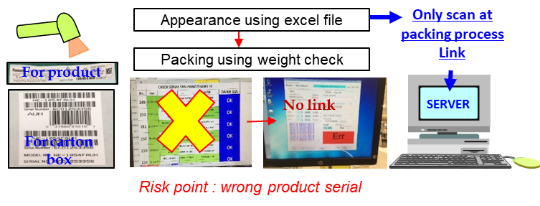
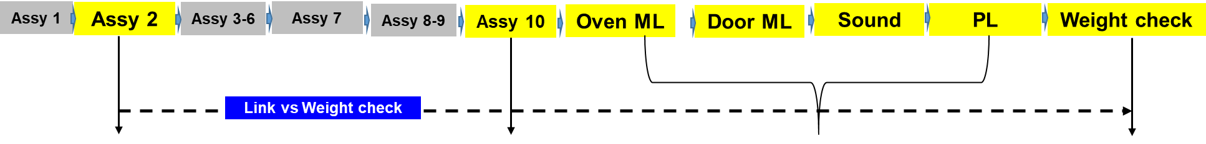
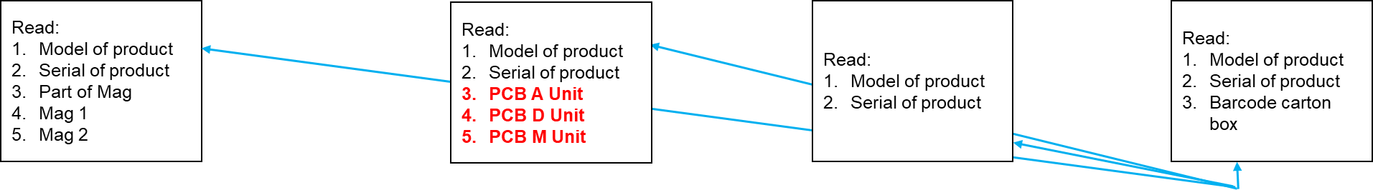
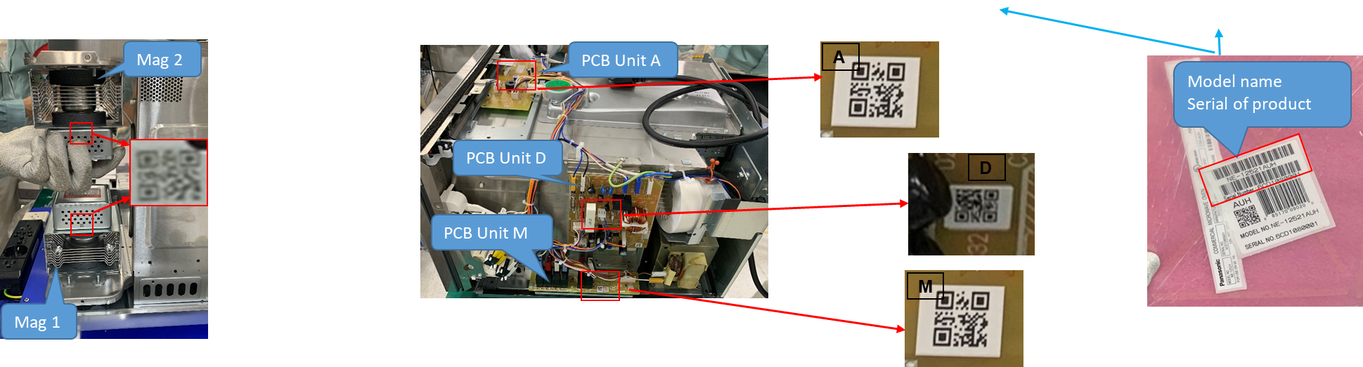
KABD - FY2022 Improvement Activity
BU | FY22 Action | Plan / Schedule | Concerned Department
KABD | Auto Creat Part Card : Print Label Area & Prepararion Area | Plan : MW : Print Label Area Schedule : Jun.2022 – Jul.2022 | IT
 | Compare carton serial & product serial by Weight check | Plan : OCS : 1 Line 18L : 1 Line Schedule : May.22 : OCS line Jun.22 : 18L line | IT
 | Traceability (PCB & Magnetron) | Plan : SCV : 5 models Schedule : Jul – Aug.2022 | IT

Slide 5
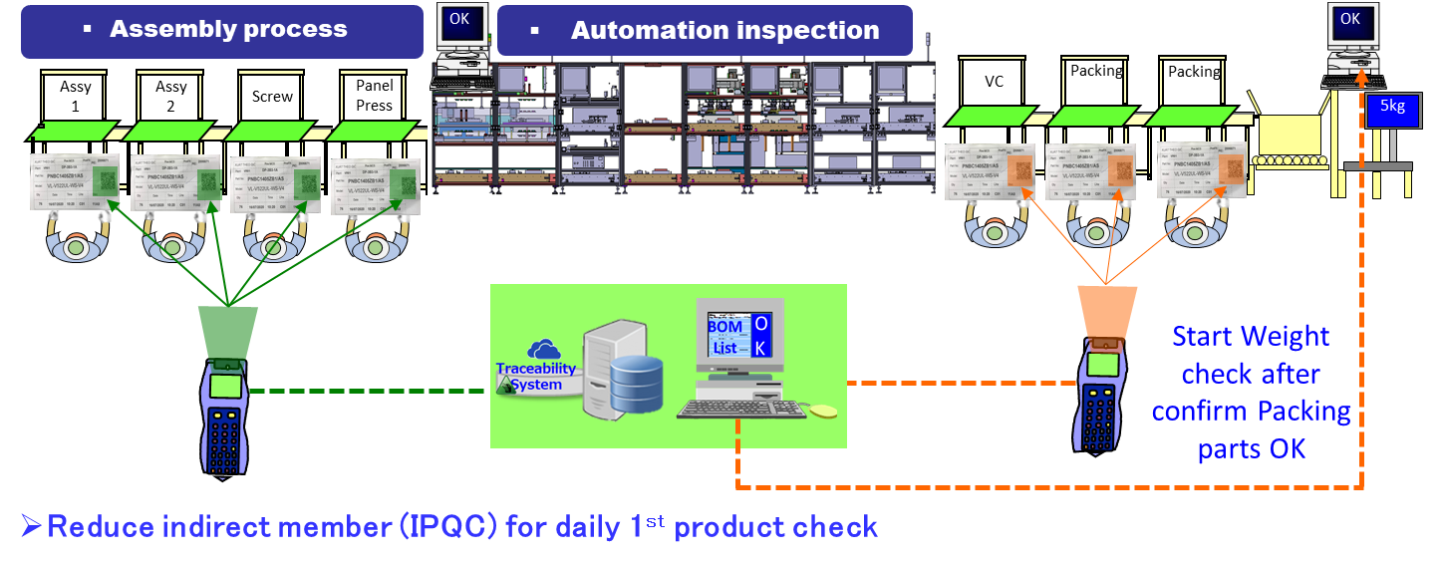
KABD - FY2022 Improvement Activity
BU | FY22 Action | Plan / Schedule
KABD | Verify Part Number by Read Barcode of Part Card (Auto compare with BOM list) | Plan : MW : Print Label Area Schedule : Jun.2022 – Jul.2022

